Slide 1
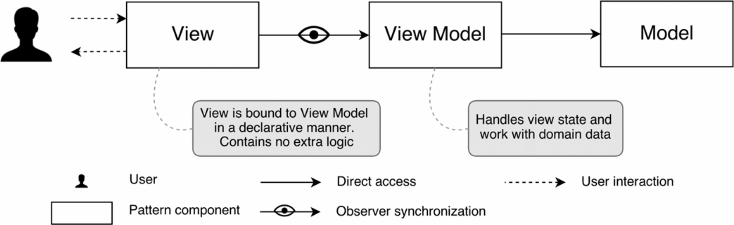
GPS_Frontend
User Interface to interact with GPS_Tracker
Single Page Application (SPA)
Based on web technologies
Main features
Model-View-ViewModel design pattern
Parallel execution, asynchronous calls
Reactivity
Extensibility
Representation of MVVM design pattern elements

Slide 2



Technologies for GPS_Frontend
Components
VueJS – a Javascript framework for SPA
Vuex – data storage library
Vuerouter – URL path router
Plotly – plotting library
Bootstrap – web design library
Alternatives
Angular – by Google, functional, but monolithic
React – by Facebook, flexible, but not easy-to-go
VueJS – by community, flexible, lightweight, but not so functional
The most popular libraries logos for modern web projects: Angular, React, VueJS

Slide 3
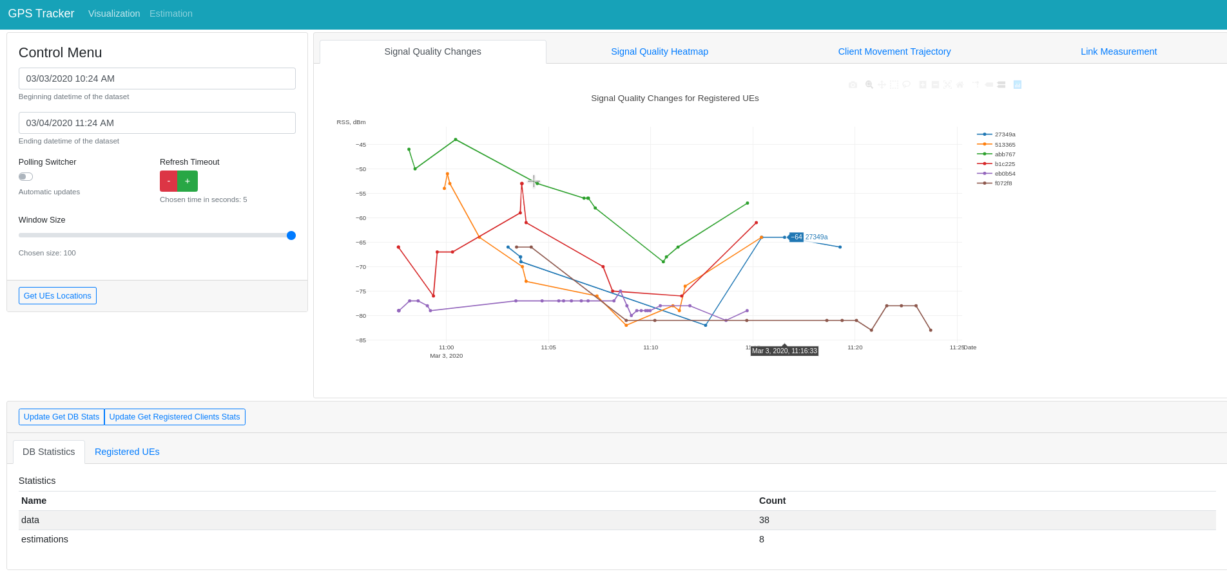
GPS_Frontend-Visualization
Timeframe,
update
frequency
configuration
Location data on given
timeframe
Database
statistics
Layout of the UI implemented by GPS_Frontend. The user access UI in a web-browser

Slide 4
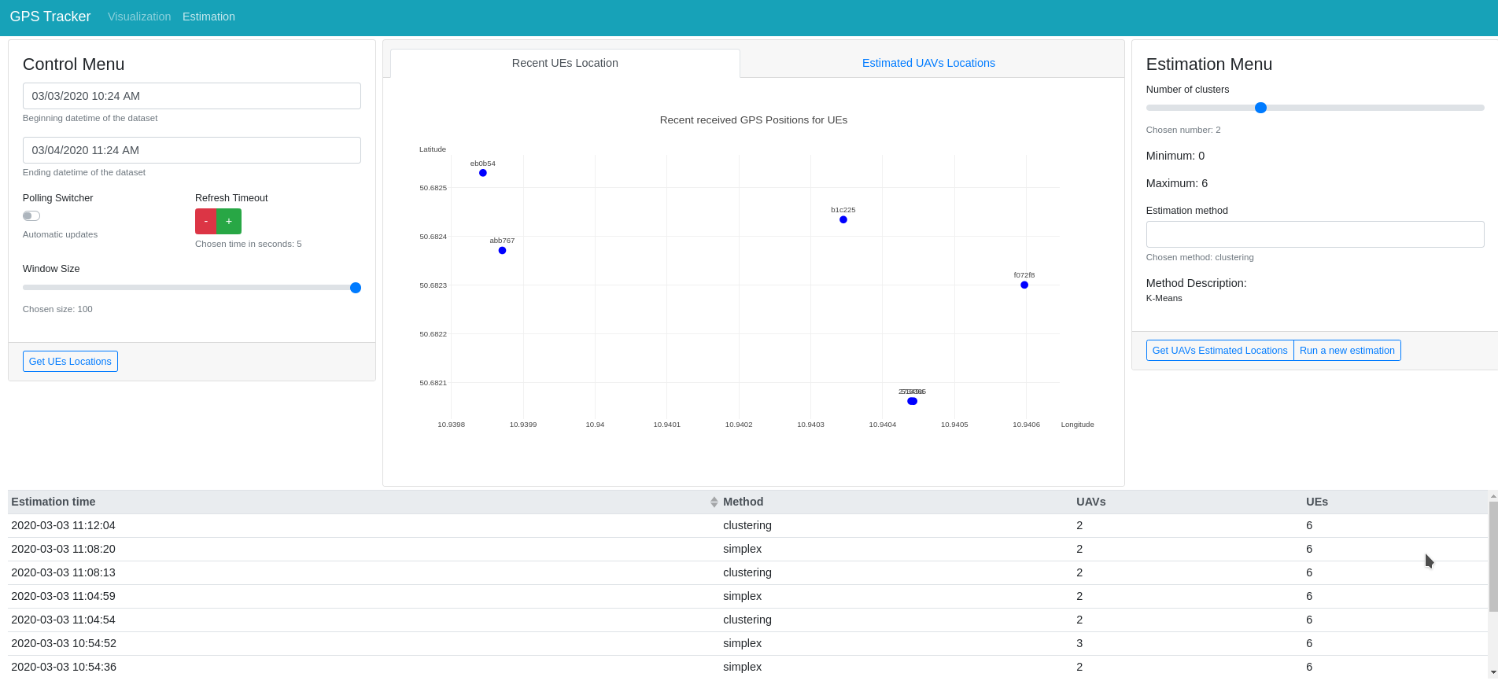
GPS_Frontend-Estimation
UEs positions for optimization task
Choose parameters for new task
Available task results

Slide 5
GPS_Tracker
Functions
Serve HTTP REST inquires
Process incoming messages from GPS_Android
Dispatch optimization tasks
Key features
Worker design pattern
Python programming language
Key technologies
Lightweight Flask library for HTTP server
Celery task scheduling library
MongoDB NoSQL database
RabbitMQ message queue

Slide 6
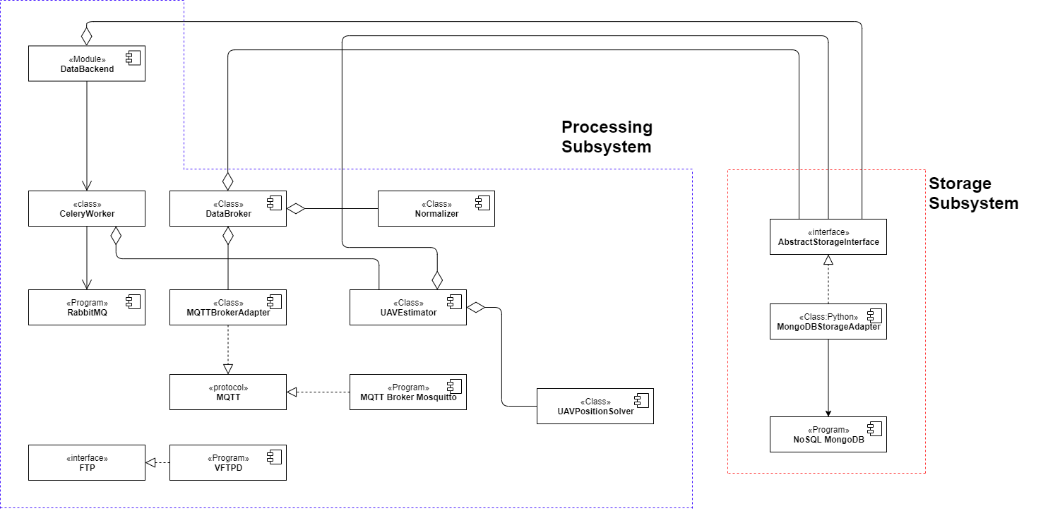
GPS_Tracker Subsystems
Component Diagram for GPS_Tracker subsystems

Slide 7
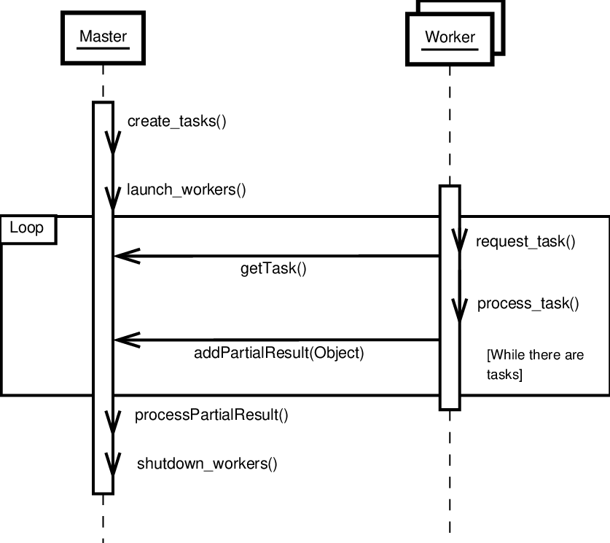
Master-Worker Interaction Diagram
A typical interaction diagram for Worker design pattern

Slide 8
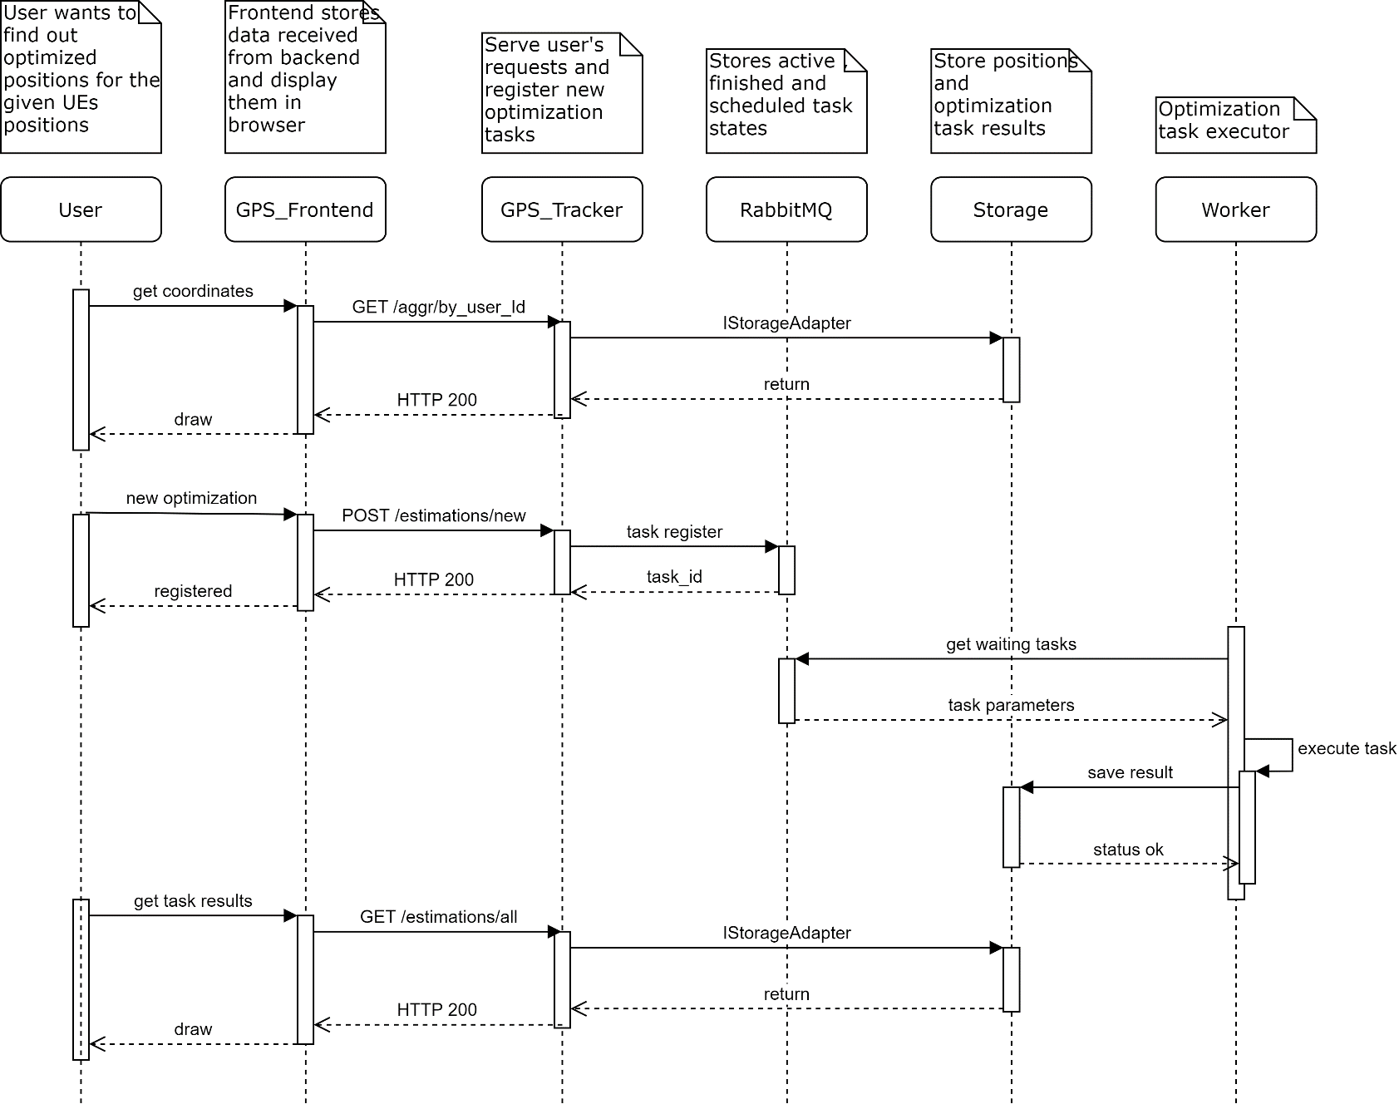
UI And Backend Interaction
New optimization task registration

Slide 9
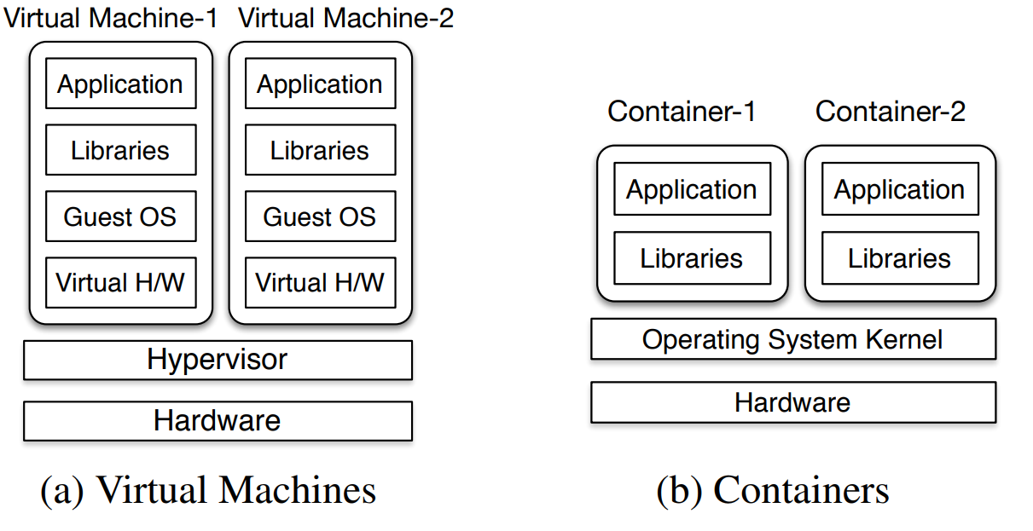
System Component Deployment
Two main cases
Bare-metal installation
Containerized deployment
Key features
Interaction via network
Components can be separated geographically
Virtual machines and containers runtime
Reason for virtual machines
Independence of hardware
Virtual hardware specification control
Single way of installation – just bring an VM image
Reason for containers
Provide ready-to-use program environment
Concept isolation – explicit specification of dependencies
Resource isolation – cgroups and namespaces
Convenient development and deployment
Abstraction Layers for Hardware and Operation system virtualization

Slide 10
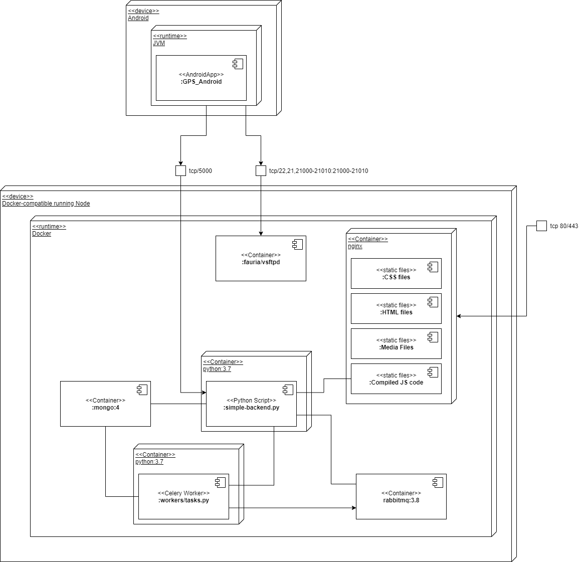
Deployment Diagram

Slide 11
References
A. Syromiatnikov and D. Weyns, "A Journey through the Land of Model-View-Design Patterns," 2014 IEEE/IFIP Conference on Software Architecture, Sydney, NSW, 2014, pp. 21-30. doi: 10.1109/WICSA.2014.13
Ropero, Juan & Tamura, Gabriel. (2017). Characterizing the Impact of Context-Variables in Software Performance Factors: a Domain-Specific Design Patterns Perspective. 10.13140/RG.2.2.13879.42408.
Prateek Sharma, Lucas Chaufournier, Prashant Shenoy, and Y. C. Tay. 2016. Containers and Virtual Machines at Scale: A Comparative Study. In Proceedings of the 17th International Middleware Conference (Middleware ’16). Association for Computing Machinery, New York, NY, USA, Article 1, 1–13.

